Slide 1
Stack alignment
Use cases
Work (WBS)
Present
All users
Sub-portfolio facing
Sub-portfolio
Project
Project
2020
All users
Sub-portfolio facing
Product facing
Sub-portfolio
Project
Project
2022
All users
Sub-portfolio facing
Product facing
Sub-portfolio
Project
Project
IT (SBS)
Application
Use case
Service
Instance
Platform
VM /OS
Edge device
Infrastructure
& Data
Network
Server
Storage
Name | Org Unit Presentation Title
dd/mm/yyyy

Slide 2
Alternate Stack alignment when more mature, if going more in Product direction for all Enterprise use cases in future
Product (PBS)
Work (WBS)
Product family 1
Product
Product
Sub-portfolio
Project
Project
Product family 2
Product
Product
Sub-portfolio
Project
Project
Product family 3
Product
Product
Sub-portfolio
Project
Project
IT (SBS)
Application
Use case
Service
Instance
Platform
VM /OS
Edge device
Infrastructure
& Data
Network
Server
Storage
Name | Org Unit Presentation Title
dd/mm/yyyy

Slide 3
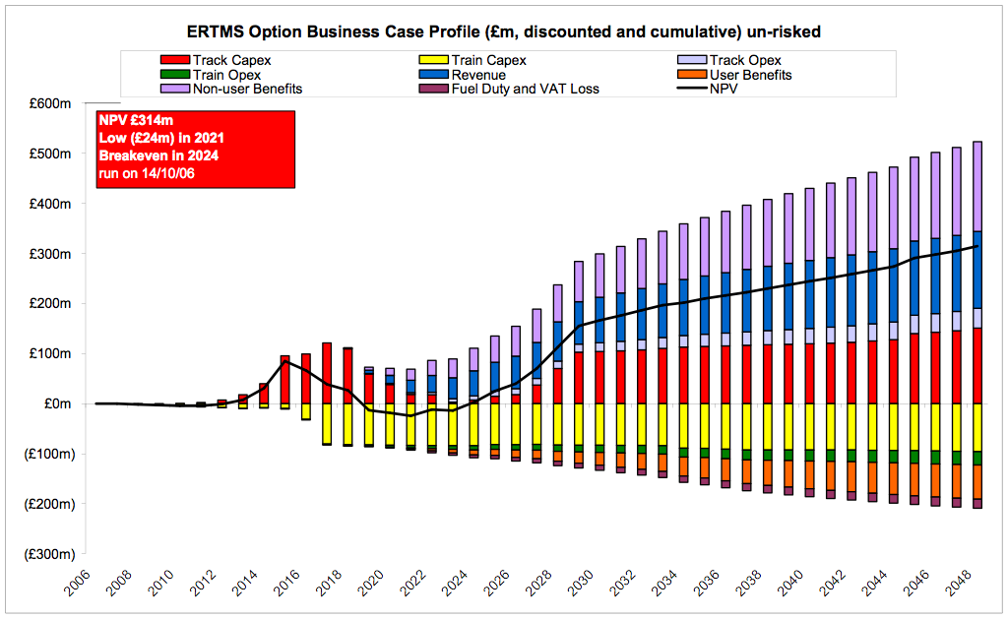
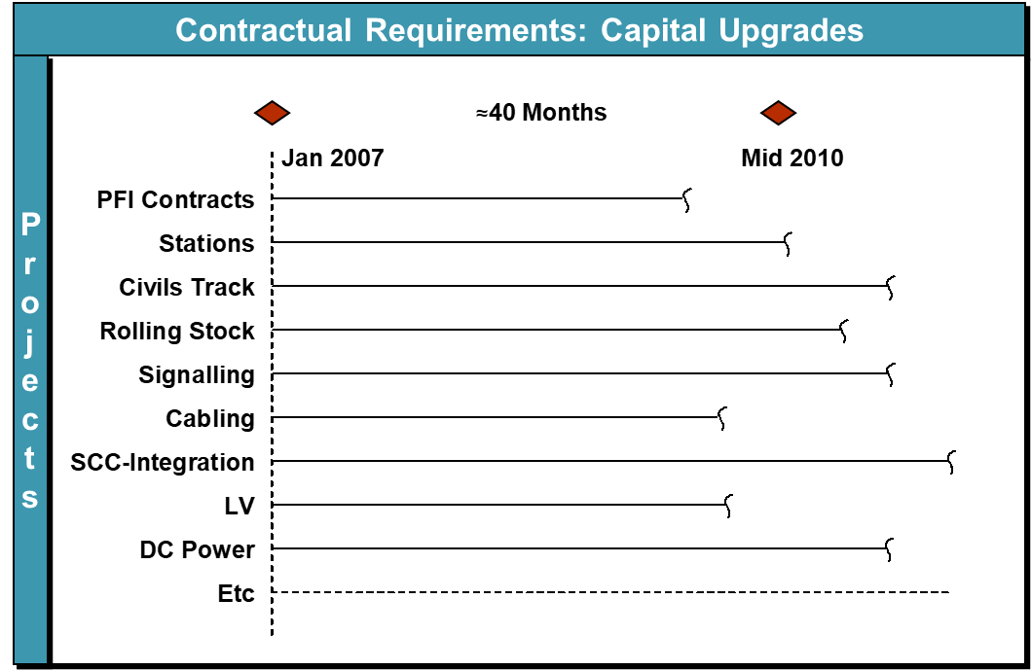
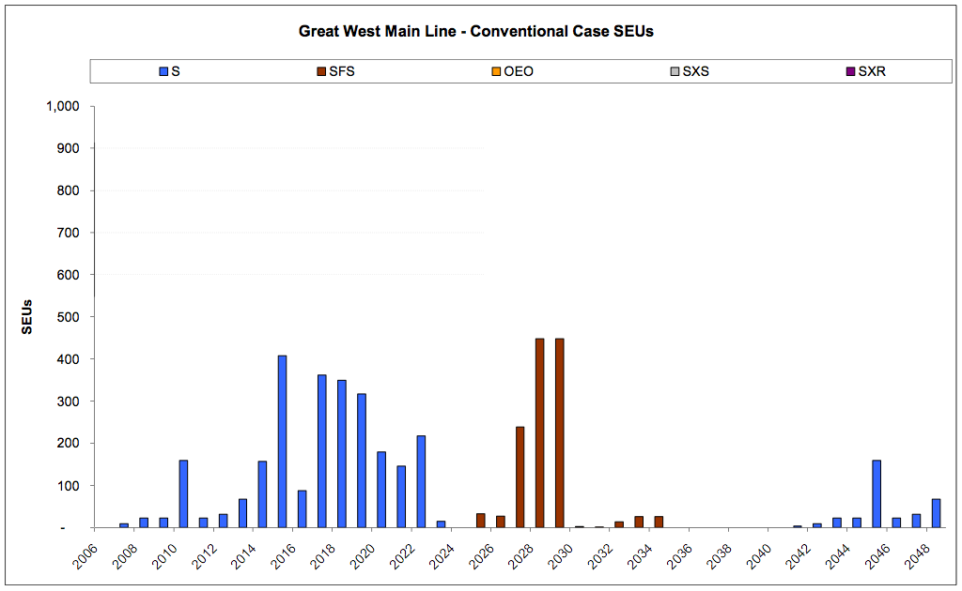
Lifecycle alignment
Portfolio & project development
Portfolio roadmap
Project Stages (Project Framework)
Requirement
Technical development
test
Design
Development
Build
Service & asset renewal & replacement
Name | Org Unit Presentation Title
dd/mm/yyyy

Slide 4
Core steering artefact
STRATEGY
RIGHT PLAN
RIGHT PERFORMANCE
Decisions
Communicate
Information
Plan
Information
PORTFOLIO
RIGHT DELIVERY
Decisions
Information
Deliver
PROJECTS
Name | Org Unit Presentation Title
dd/mm/yyyy

Slide 5
The ideal working format for a Core Tech Steering Gp
Outputs
Risks
Performance
Stage 1
Interfaces
Agreements
2019 Projects Content
2 Month Verification
10 Month Duration
Outputs
Stage 2
2020 projects content
10 Month Duration
Interface Transitions
Stage 3
Existing
Interim
Final
Working Test
2021 Projects content
10 Month Duration
Name | Org Unit Presentation Title
dd/mm/yyyy

Slide 6
Questions arising: which way do we face ? More towards the business functions or towards our IT Vision ?
How much are we as a service department providing one enabler to delivering overall Organisation business model
How much is our vision and roadmap of the IT stack critical to be defended and advocated within the Enterprise ?
OR
Organisation business model
Organisation future business model
Delivers
OR
Organisation functions, programmes and products
Demands
Organisation functions, programmes and products
anticipates
Inspires and informs
Actively manages services and costs
Serves on request
Organisation IT
Actively Curate Organisation IT estate
PLUS
Building a Organisation IT Vision
Sub-portfolio focussed
IT Lifecycle, IT Roadmap focussed

